Slide 1
The “isms”faced by Orwell:
Capitalism Down and Out in Paris and London
Totalitarianism/Statism:
Communism/Stalinism Animal Farm
Fascism/Nationalism Homage to Catalonia; 1984; “Notes on Nationalism”
Democratic Socialism “The Lion and the Unicorn: Socialism and the English Genius”;
The Road to Wigan Pier

Slide 2
Hannah Arendt, The Origins of Totalitarianism, 1951
Timothy Snyder, Bloodlands, 2010
“The Confession,” Costa-Gavros, 1970

Slide 3
Capitalism leads to dole queues, the scramble for markets, and war. Collectivism leads to concentration camps, leader worship, and war. There is no way out of this unless a planned economy can somehow be combined with the freedom of the intellect, which can only happen if the concept of right and wrong is restored to politics.
Review of The Road to Serfdom by F.A. Hayek & The Mirror of the Past by K. Zilliacus, reviewed in The Observer (9 April 1944).

Slide 4
Every line of serious work that I have written since 1936 has been written, directly or indirectly, against totalitarianism and for democratic Socialism, as I understand it. It seems to me nonsense, in a period like our own, to think that one can avoid writing of such subjects.
"Why I Write," Gangrel (Summer 1946)

Slide 5
"One could not have a better example of the moral and emotional shallowness of our time, than the fact that we are now all more or less pro Stalin. This disgusting murderer is temporarily on our side, and so the purges, etc., are suddenly forgotten.“
— George Orwell, in his war-time diary, 3 July 1941

Slide 6
Now, comrades, what is the nature of this life of ours? Let us face
It, our lives are miserable, laborious and short. We are born, we are
Given just so much food as will keep the breath in our bodies, and
Those of us who are capable of it are forced to work to the last atom
of our strength; and the very instant that our usefulness has come
to an end we are slaughtered with hideous cruelty. No animal in
England knows the meaning of happiness or leisure after he is a year
old. No animal in England is free. The life of an animal is misery
and slavery: that is the plain truth.
Animal Farm, 3
…and which is worst of all, continual fear, and danger of violent
Death; And the life of man is solitary, poor, nasty, brutish, and short.
Thomas Hobbes, Leviathan

Slide 7
Collectivization

Slide 8
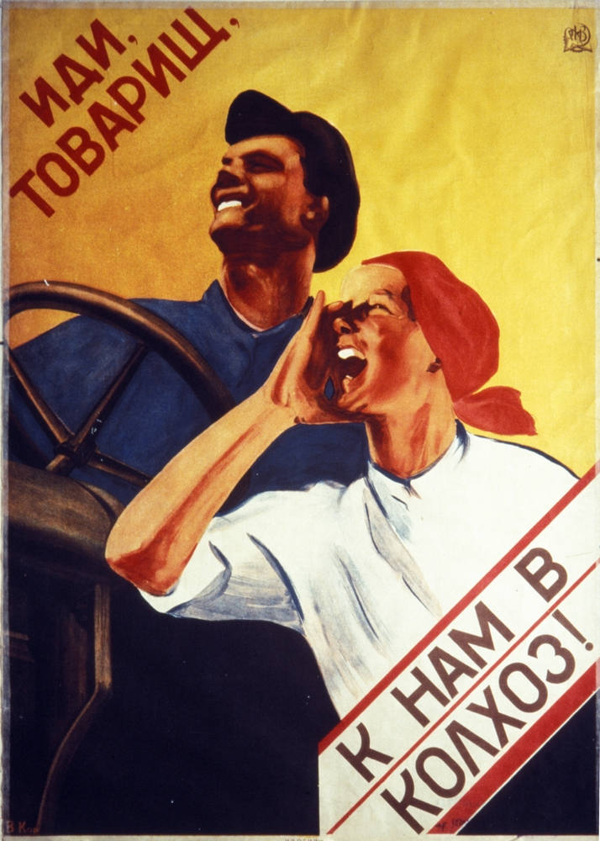
Hey Comrade. With us to the collective!

Slide 9
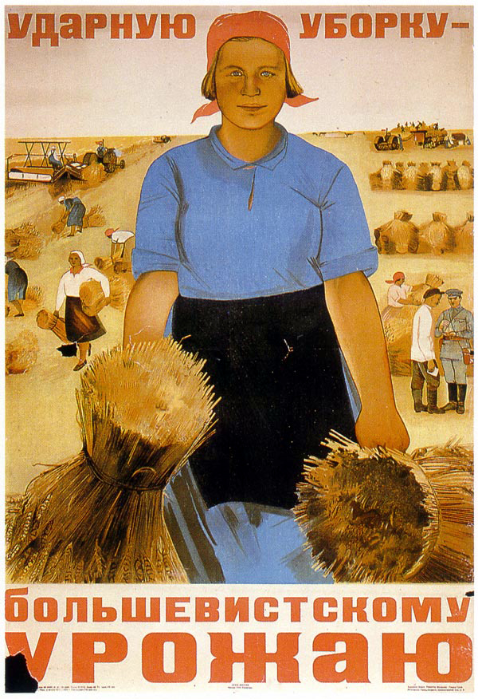
Bolshevist Harvesting

Slide 10
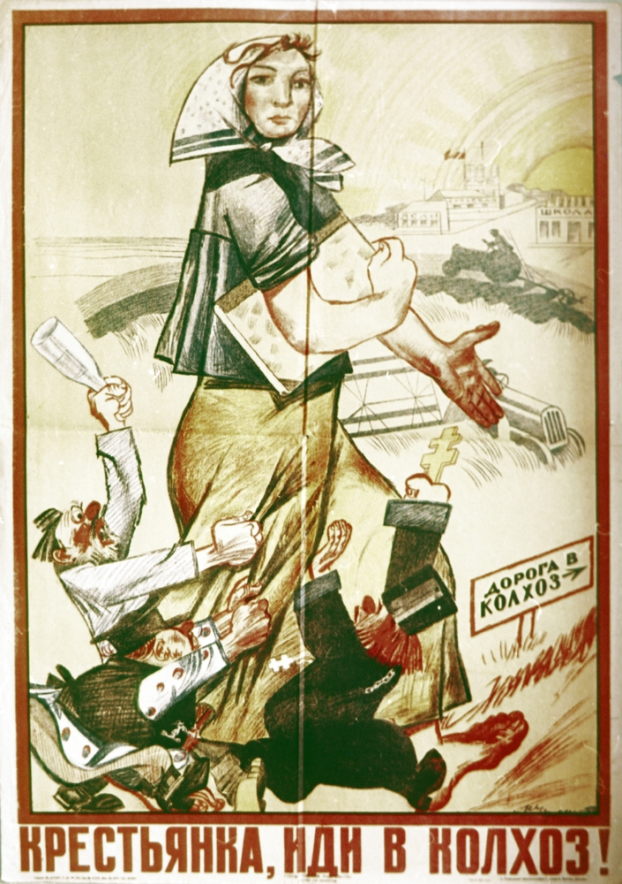
Peasant Woman – join the collective!
Notes:
Peasant Woman – join the collective!

Slide 11


Slide 12


Slide 13
Holodomor

Slide 14
Death by Starvation

Slide 15
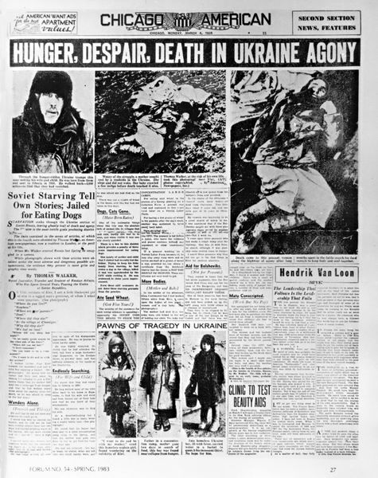

Slide 16
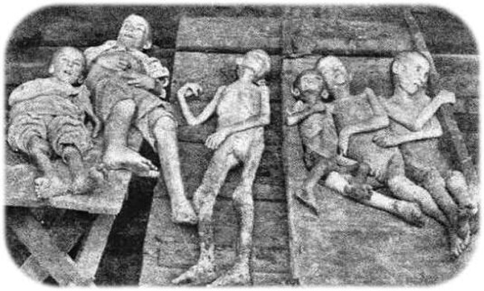

Slide 17
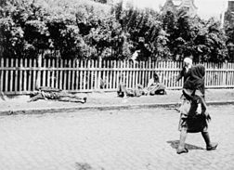

Slide 18
If she could have spoken her thoughts, it would have been to say that this was not what they had aimed at when they had set themselves years ago to work for the overthrow of the human race. These scenes of terror and slaughter were not what they had looked forward to on that night when old Major first stirred them to rebellion. If she herself had had any picture of the future, it had been of a society of animals set free from hunger and the whip, all equal, each working according to his capacity, the strong protecting the weak, as she had protected the lost brood of ducklings with her foreleg on the night of Major's speech. Instead--she did not know why--they had come to a time when no one dared speak his mind, when fierce, growling dogs roamed everywhere, and when you had to watch your comrades torn to pieces after confessing to shocking crimes. There was no thought of rebellion or disobedience in her mind. She knew that, even as things were, they were far better off than they had been in the days of Jones, and that before all else it was needful to prevent the return of the human beings. Whatever happened she would remain faithful, work hard, carry out the orders that were given to her, and accept the leadership of Napoleon. But still, it was not for this that she and all the other animals had hoped and toiled. It was not for this that they had built the windmill and faced the bullets of Jones's gun. Such were her thoughts, though she lacked the words to express them.

Slide 19
“Beasts of England”
7-8

Slide 20
The International
No more deluded by reaction On tyrants only we’ll make war The soldiers too will take strike action They’ll break ranks and fight no more And if those cannibals keep trying To sacrifice us to their pride They soon shall hear the bullets flying We’ll shoot the generals on our own side. No saviour from on high delivers No faith have we in prince or peer Our own right hand the chains must shiver Chains of hatred, greed and fear E’er the thieves will out with their booty And give to all a happier lot. Each at the forge must do their duty And we’ll strike while the iron is hot.
Arise ye workers from your slumbers Arise ye prisoners of want For reason in revolt now thunders And at last ends the age of cant. Away with all your superstitions Servile masses arise, arise We’ll change henceforth the old tradition And spurn the dust to win the prize. Refrain: So comrades, come rally And the last fight let us face The Internationale unites the human race.

Slide 21
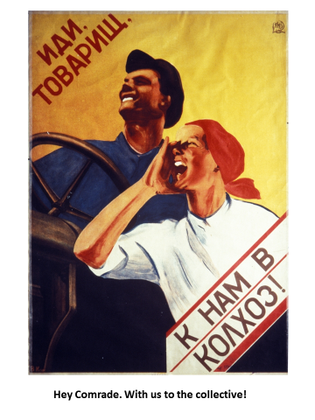

Slide 22
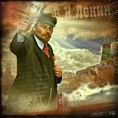

Slide 23


Slide 24


Slide 25
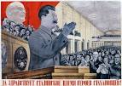

Slide 26
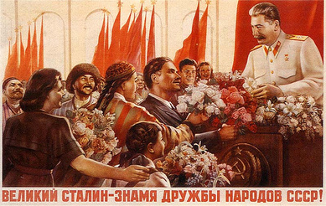
“Great Stalin, he leads with the friendship of the people of USSR!"

Slide 27
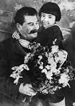

Slide 28
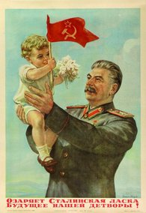
"Stalin's kindness brightens the future of our children!"

Slide 29
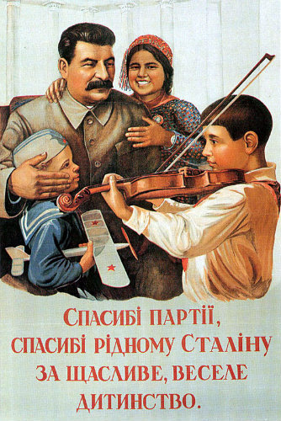
"Thank you to our party and to Stalin for our happy and fun childhood."

Slide 30
"Every step, play time and lesson Is joyful as never before Because great Stalin is for the Children Our very best friend Joyful song, sing it loud About our happy childhood Thank you great Stalin For our wondrous days“ ~ I. Dobrovol'skii, Thank You Great Stalin

Slide 31
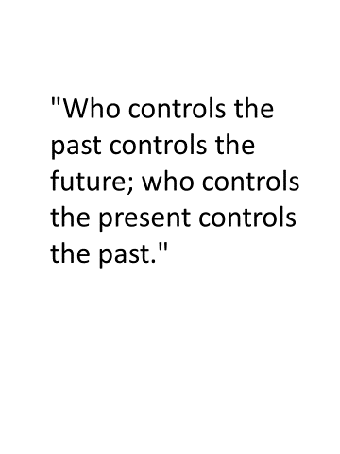

Slide 32
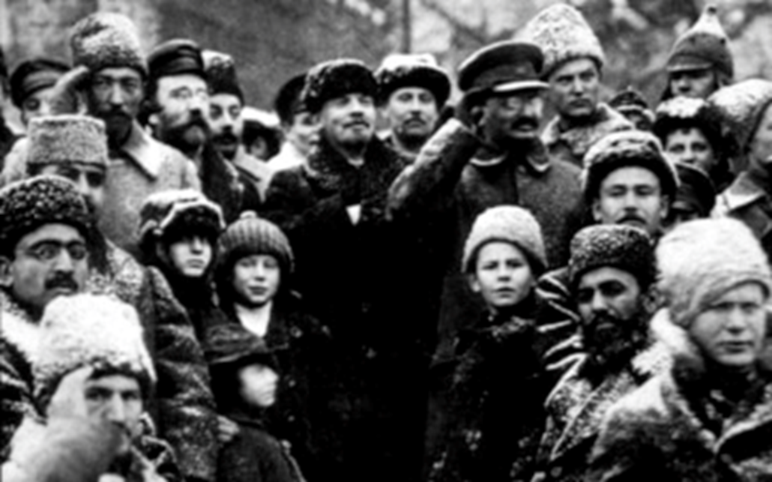

Slide 33
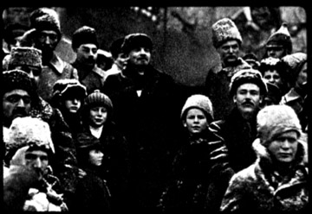

Slide 34
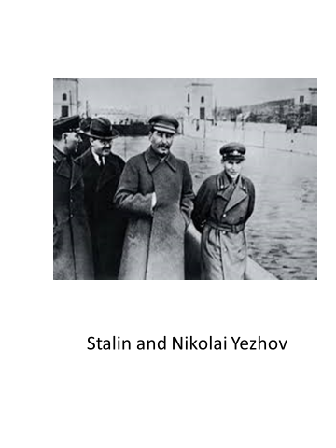

Slide 35
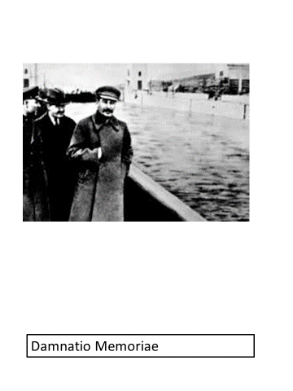

Slide 37
“Beasts of England”
60

Slide 38
“I was totally against the war in Iraq.”
Donald Trump
“Alternative Facts”

Slide 39
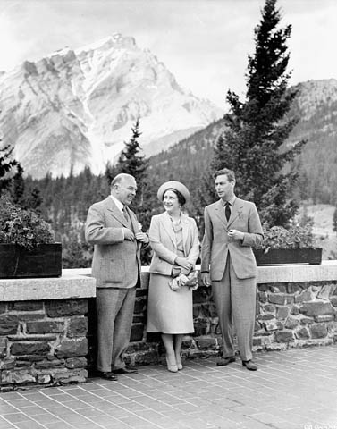

Slide 40
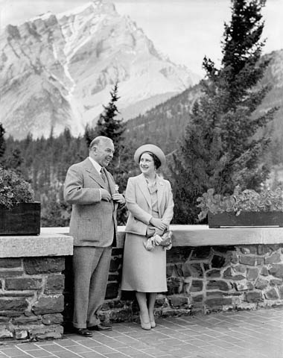
Notes:
1939: Perhaps King thought he looked more impressive without another male authority figure in the picture. In any case he used it as a campaign photo in the next election.

